Slide 1

LEARN & IMPROVE Online Learning Platform Department of Computer Science and Engineering
Submitted by Project Supervisor
Rahul (11722210012)Dr.Rakesh Ahuja
Anuj Pal (11722210019) Department of Computer Science &
Parshant(11722210013) Engineering
Group No.31
Academic Year 2025-26

Slide 2
Content of Table
Methodology / Workflow
1.1Step-by-step working of the platform 1.2Flowchart
Technologies Used
2.1Programming languages 2.2Frameworks 2.3Tools & Database
Implementation Details
3.1Algorithms used
3.2Data processing techniques
3.3Security / optimization techniques

Slide 3
Implementation & Development
Project Title:
LEARN & IMPROVE Online Learning Platform
This review focuses on:
System implementation approach
Technologies used in development
Core learning workflows and data handling
Security and optimization techniques used in the platform

Slide 4
System Methodology
The platform follows a user-centered learning workflow where courses, content, and progress are managed in real time.
Step-by-Step Working of the System
User signs up/logs in to the dashboard.
User browses courses and views details.
Student adds a course to cart and initiates payment.
Razorpay creates a payment order and verifies the transaction.
On success, the backend enrolls the student.
Course sections and lectures are fetched from MongoDB.
Cloudinary serves thumbnails and video assets.
Course data is sent to the frontend through REST APIs.JWT-protected endpointsensure role-based access.
The dashboard updates progress and learning stats.
Ratings and reviews are stored for course feedback.

Slide 5
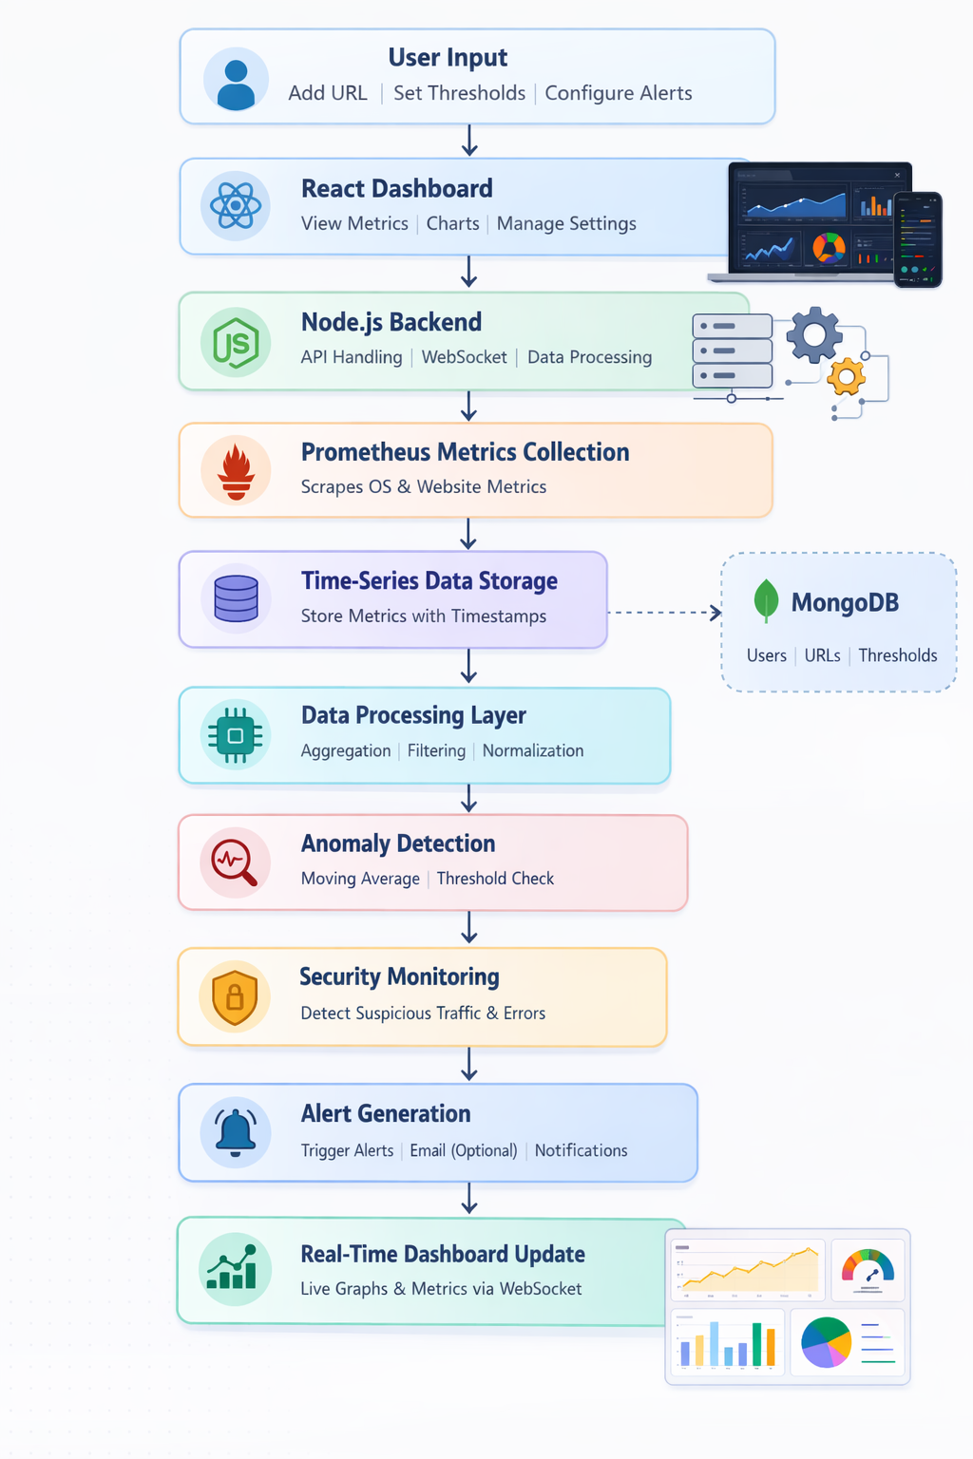
Process Flow
.
User InputThe user signs up/logs in, browses courses, and selects a course to purchase.
React DashboardThe dashboard provides the interface for course catalog, learning, and profile settings.
Node.js BackendThe backend manages APIs, authentication, and course operations.
MongoDB Data StorageStores users, courses, sections, enrollments, and progress data.
Cloudinary Media StorageStores course thumbnails and lecture videos.
Payment ProcessingRazorpay handles order creation, payment, and verification.
Enrollment & ProgressStudents are enrolled and progress is tracked per lecture.
Ratings & ReviewsStudents submit ratings and feedback for courses.
Email NotificationsEmails are sent for OTP, password reset, and enrollment.
Dashboard UpdateThe dashboard fetches updated data via REST APIs.

Slide 6

Technologies Used
Programming Languages
The system uses the following programming languages:
JavaScript Used for both frontend and backend development.
HTML & CSSUsed for building and styling the user interface. JSON
Used for API request/response payloads. These languages help build a
full-stack online learning platform.

Slide 7
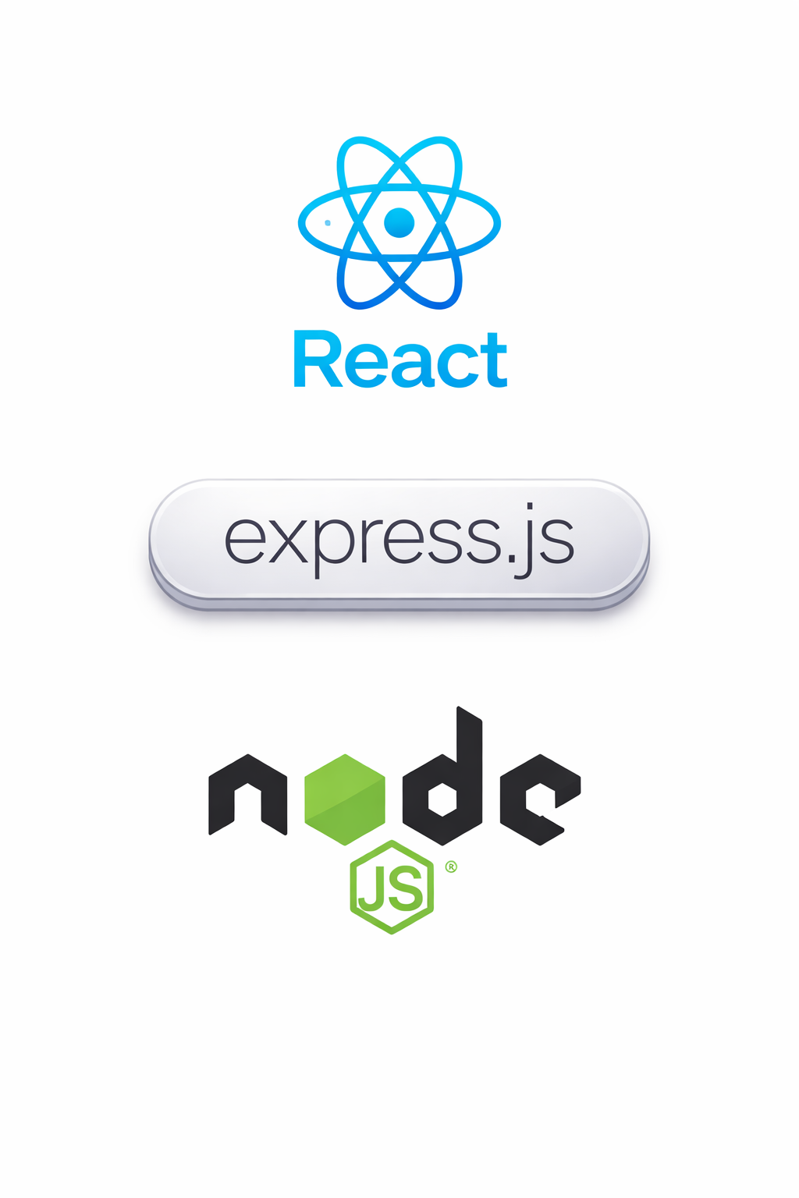
Frameworks
The system is built using modern development frameworks:
React Used to build the interactive dashboard interface.
Express.js Used to create REST APIs in the backend.
Node.js Used for server-side processing and API handling.
These frameworks enablefast development and scalable learning workflows.

Slide 8

Tools & Database
The system uses the following tools and platforms:
MongoDB Stores users, courses, enrollments, and progress data.
Cloudinary Used for media upload and delivery (images/videos).
Razorpay Used for secure payment processing.
GitHub Used for source code management and collaboration.
These tools help create ascalable and maintainable learning system.

Slide 9
Implementation Details
Algorithms Used
The system uses practical algorithms for authentication and learning analytics.
Main algorithms include:
1. Password Hashing (bcrypt)
Used to securely store user passwords. 2. JWT Authentication
Validates users and protects role-based routes.
3. Average Rating Calculation Aggregates ratings for each course.
4. Progress Percentage

Slide 10
Data Processing Techniques
The system processes learning data using the following techniques:
Course Content Aggregation
Lecture durations are summed for total course time.
Enrollment Mapping Users are linked to courses and progress is tracked.
Media Upload Pipeline Videos and thumbnails are uploaded to Cloudinary.REST API Data Fetching
Frontend fetches catalog, course, and dashboard data.These techniques allow the system to
handle continuous learning data efficiently

Slide 11
Security & Optimization Techniques
The system also includes basic security and optimization measures:
Security Techniques
JWT-based authentication for protected routes
Role-based access control (Student/Instructor/Admin)
Input validation for forms and IDs
Optimization Techniques
Cloudinary for optimized media deliveryReduced payloads by excluding video URLs in public course details
Efficient MongoDB queries with population
These techniques improve
system performance, reliability, and user safety..

Slide 12
